Slide 1
The Linux System

Slide 2
The Linux System
Design Principles
Kernel Modules
Process Management
Scheduling
Memory Management
Inter-process Communication
Network Structure
Security

Slide 3
Design Principles
Linux is a multiuser, multitasking system with a full set of UNIX-compatible tools
Its file system adheres to traditional UNIX semantics, and it fully implements the standard UNIX networking model
Main design goals are speed, efficiency, and standardization
Linux is designed to be compliant with the relevant POSIX documents; at least two Linux distributions have achieved official POSIX certification
Supports Pthreads and a subset of POSIX real-time process control
The Linux programming interface adheres to the SVR4 UNIX semantics, rather than to BSD behavior

Slide 4
Kernel Modules
Sections of kernel code that can be compiled, loaded, and unloaded independent of the rest of the kernel.
A kernel module may typically implement a device driver, a file system, or a networking protocol
The module interface allows third parties to write and distribute, on their own terms, device drivers or file systems that could not be distributed under the GPL.
Kernel modules allow a Linux system to be set up with a standard, minimal kernel, without any extra device drivers built in.
Four components to Linux module support:
module-management system
module loader and unloader
driver-registration system
conflict-resolution mechanism

Slide 5
Process Management
UNIX process management separates the creation of processes and the running of a new program into two distinct operations.
The fork() system call creates a new process
A new program is run after a call to exec()
Under UNIX, a process encompasses all the information that the operating system must maintain to track the context of a single execution of a single program
Under Linux, process properties fall into three groups: the process’s identity, environment, and context

Slide 6
Process Identity
Process ID (PID) - The unique identifier for the process; used to specify processes to the operating system when an application makes a system call to signal, modify, or wait for another process
Credentials - Each process must have an associated user ID and one or more group IDs that determine the process’s rights to access system resources and files
Personality - Not traditionally found on UNIX systems, but under Linux each process has an associated personality identifier that can slightly modify the semantics of certain system calls
Used primarily by emulation libraries to request that system calls be compatible with certain specific flavors of UNIX
Namespace – Specific view of file system hierarchy
Most processes share common namespace and operate on a shared file-system hierarchy
But each can have unique file-system hierarchy with its own root directory and set of mounted file systems

Slide 7
Process Environment
The process’s environment is inherited from its parent, and is composed of two null-terminated vectors:
The argument vector lists the command-line arguments used to invoke the running program; conventionally starts with the name of the program itself.
The environment vector is a list of “NAME=VALUE” pairs that associates named environment variables with arbitrary textual values.
Passing environment variables among processes and inheriting variables by a process’s children are flexible means of passing information to components of the user-mode system software.
The environment-variable mechanism provides a customization of the operating system that can be set on a per-process basis, rather than being configured for the system as a whole.

Slide 8
Process Context
The (constantly changing) state of a running program at any point in time
The scheduling context is the most important part of the process context; it is the information that the scheduler needs to suspend and restart the process
The kernel maintains accounting information about the resources currently being consumed by each process, and the total resources consumed by the process in its lifetime so far
The file table is an array of pointers to kernel file structures
When making file I/O system calls, processes refer to files by their index into this table, the file descriptor (fd)
Whereas the file table lists the existing open files, the file-system context applies to requests to open new files
The current root and default directories to be used for new file searches are stored here
The signal-handler table defines the routine in the process’s address space to be called when specific signals arrive
The virtual-memory context of a process describes the full contents of the its private address space

Slide 9
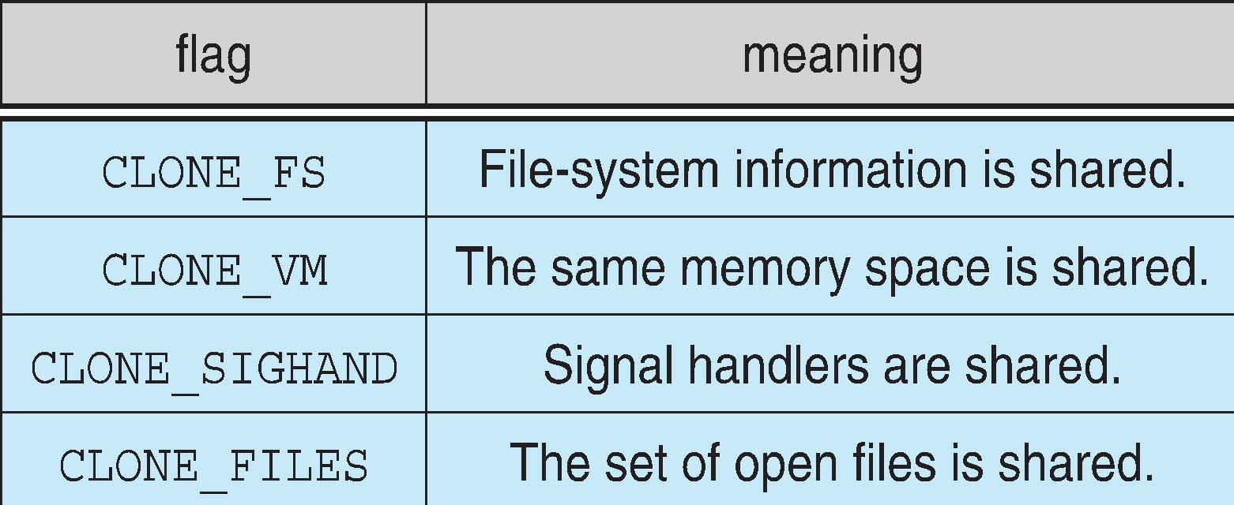
Processes and Threads
Linux uses the same internal representation for processes and threads; a thread is simply a new process that happens to share the same address space as its parent
Both are called tasks by Linux
A distinction is only made when a new thread is created by the clone() system call
fork() creates a new task with its own entirely new task context
clone() creates a new task with its own identity, but that is allowed to share the data structures of its parent
Using clone() gives an application fine-grained control over exactly what is shared between two threads

Slide 10
Scheduling
The job of allocating CPU time to different tasks within an operating system
While scheduling is normally thought of as the running and interrupting of processes, in Linux, scheduling also includes the running of the various kernel tasks
Running kernel tasks encompasses both tasks that are requested by a running process and tasks that execute internally on behalf of a device driver
As of 2.5, new scheduling algorithm – preemptive, priority-based, known as O(1)
Real-time range
nice value
Had challenges with interactive performance
2.6 introduced Completely Fair Scheduler (CFS)

Slide 11
CFS
Eliminates traditional, common idea of time slice
Instead all tasks allocated portion of processor’s time
CFS calculates how long a process should run as a function of total number of tasks
N runnable tasks means each gets 1/N of processor’s time
Then weights each task with its nice value
Smaller nice value -> higher weight (higher priority)
Then each task run with for time proportional to task’s weight divided by total weight of all runnable tasks
Configurable variable target latency is desired interval during which each task should run at least once
Consider simple case of 2 runnable tasks with equal weight and target latency of 10ms – each then runs for 5ms
If 10 runnable tasks, each runs for 1ms
Minimum granularity ensures each run has reasonable amount of time (which actually violates fairness idea)

Slide 12
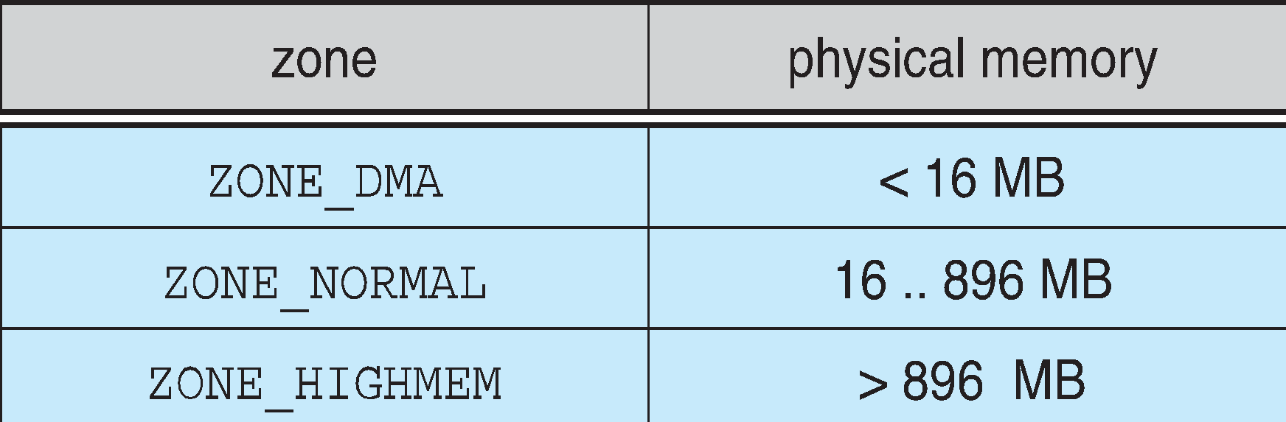
Memory Management
Linux’s physical memory-management system deals with allocating and freeing pages, groups of pages, and small blocks of memory
It has additional mechanisms for handling virtual memory, memory mapped into the address space of running processes
Splits memory into four different zones due to hardware characteristics
Architecture specific, for example on x86:

Slide 13
Managing Physical Memory
The page allocator allocates and frees all physical pages; it can allocate ranges of physically-contiguous pages on request
The allocator uses a buddy-heap algorithm to keep track of available physical pages
Each allocatable memory region is paired with an adjacent partner
Whenever two allocated partner regions are both freed up they are combined to form a larger region
If a small memory request cannot be satisfied by allocating an existing small free region, then a larger free region will be subdivided into two partners to satisfy the request
Memory allocations in the Linux kernel occur either statically (drivers reserve a contiguous area of memory during system boot time) or dynamically (via the page allocator)
Also uses slab allocator for kernel memory
Page cache and virtual memory system also manage physical memory
Page cache is kernel’s main cache for files and main mechanism for I/O to block devices
Page cache stores entire pages of file contents for local and network file I/O

Slide 14
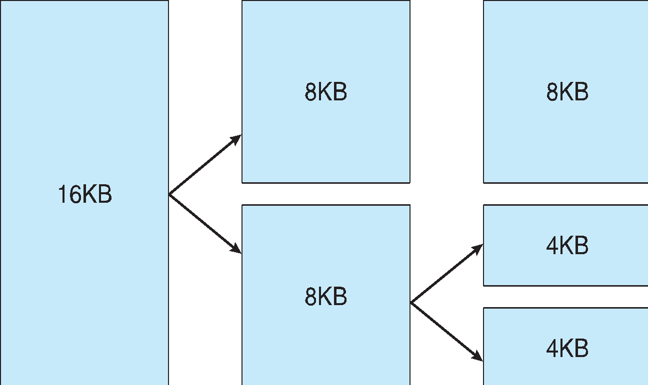
Splitting of Memory in a Buddy Heap

Slide 15
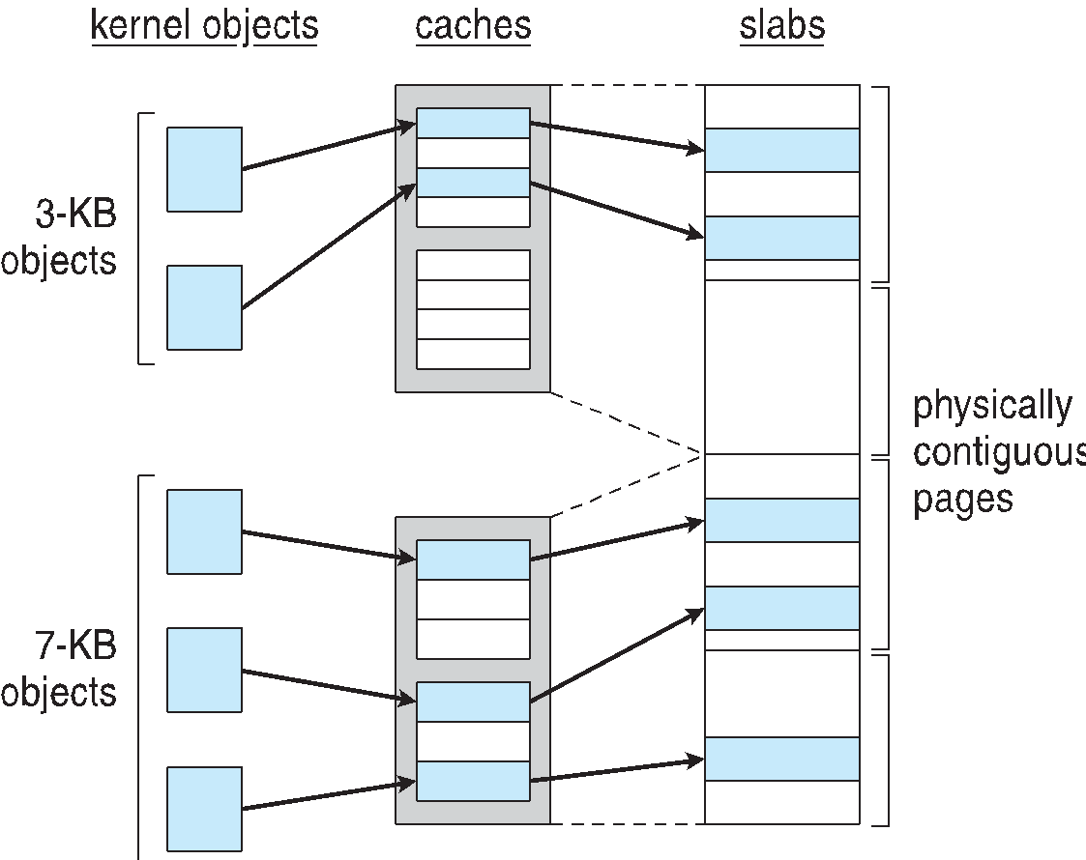
Slab Allocator in Linux

Slide 16
Virtual Memory
The VM system maintains the address space visible to each process: It creates pages of virtual memory on demand, and manages the loading of those pages from disk or their swapping back out to disk as required.
The VM manager maintains two separate views of a process’s address space:
A logical view describing instructions concerning the layout of the address space
A physical view of each address space which is stored in the hardware page tables for the process
Virtual memory regions are characterized by:
The backing store, which describes from where the pages for a region come; regions are usually backed by a file or by nothing (demand-zero memory)
The region’s reaction to writes (page sharing or copy-on-write
The kernel creates a new virtual address space
1. When a process runs a new program with the exec() system call
2. Upon creation of a new process by the fork() system call

Slide 17
Swapping and Paging
The VM paging system relocates pages of memory from physical memory out to disk when the memory is needed for something else
The VM paging system can be divided into two sections:
The pageout-policy algorithm decides which pages to write out to disk, and when
The paging mechanism actually carries out the transfer, and pages data back into physical memory as needed
Can page out to either swap device or normal files
Bitmap used to track used blocks in swap space kept in physical memory
Allocator uses next-fit algorithm to try to write contiguous runs

Slide 18
Kernel Virtual Memory
The Linux kernel reserves a constant, architecture-dependent region of the virtual address space of every process for its own internal use
This kernel virtual-memory area contains two regions:
A static area that contains page table references to every available physical page of memory in the system, so that there is a simple translation from physical to virtual addresses when running kernel code
The reminder of the reserved section is not reserved for any specific purpose; its page-table entries can be modified to point to any other areas of memory

Slide 19
Interprocess Communication
Like UNIX, Linux informs processes that an event has occurred via signals
There is a limited number of signals, and they cannot carry information: Only the fact that a signal occurred is available to a process
The Linux kernel does not use signals to communicate with processes with are running in kernel mode, rather, communication within the kernel is accomplished via scheduling states and wait_queue structures
Also implements System V Unix semaphores
Process can wait for a signal or a semaphore
Semaphores scale better
Operations on multiple semaphores can be atomic

Slide 20
Passing Data Between Processes
The pipe mechanism allows a child process to inherit a communication channel to its parent, data written to one end of the pipe can be read a the other
Shared memory offers an extremely fast way of communicating; any data written by one process to a shared memory region can be read immediately by any other process that has mapped that region into its address space
To obtain synchronization, however, shared memory must be used in conjunction with another Interprocess-communication mechanism

Slide 21
Network Structure
Networking is a key area of functionality for Linux
It supports the standard Internet protocols for UNIX to UNIX communications
It also implements protocols native to non-UNIX operating systems, in particular, protocols used on PC networks, such as Appletalk and IPX
Internally, networking in the Linux kernel is implemented by three layers of software:
The socket interface
Protocol drivers
Network device drivers
Most important set of protocols in the Linux networking system is the internet protocol suite
It implements routing between different hosts anywhere on the network
On top of the routing protocol are built the UDP, TCP and ICMP protocols
Packets also pass to firewall management for filtering based on firewall chains of rules

Slide 22
Security
The pluggable authentication modules (PAM) system is available under Linux
PAM is based on a shared library that can be used by any system component that needs to authenticate users
Access control under UNIX systems, including Linux, is performed through the use of unique numeric identifiers (uid and gid)
Access control is performed by assigning objects a protections mask, which specifies which access modes—read, write, or execute—are to be granted to processes with owner, group, or world access
Linux augments the standard UNIX setuid mechanism in two ways:
It implements the POSIX specification’s saved user-id mechanism, which allows a process to repeatedly drop and reacquire its effective uid
It has added a process characteristic that grants just a subset of the rights of the effective uid
Linux provides another mechanism that allows a client to selectively pass access to a single file to some server process without granting it any other privileges

Slide 23
Thank You

